Slide 1


Slide 2

Online University Grading System

Slide 3
Group Members Introduction
F22021F975
Mubashra Munir BC180400924

Slide 4

INTRODUCTION OF PROJECT
Grading is used to evaluate and provide feedback on student work.
In this way, instructors communicate to students how they are performing in the course and where they need more help to achieve the course’s goals.
For instructors, grades help to assess what information, concepts, and skills students have successfully understood and which ones they have not.

Slide 5
INTRODUCTION OF PROJECT
This kind of information helps you know what you may need to reiterate in class and what may require reworking in the course design.
Grades also provide a standardized way of communicating student performance to third parties, including the departments in which students are enrolled, and students themselves.

Slide 6
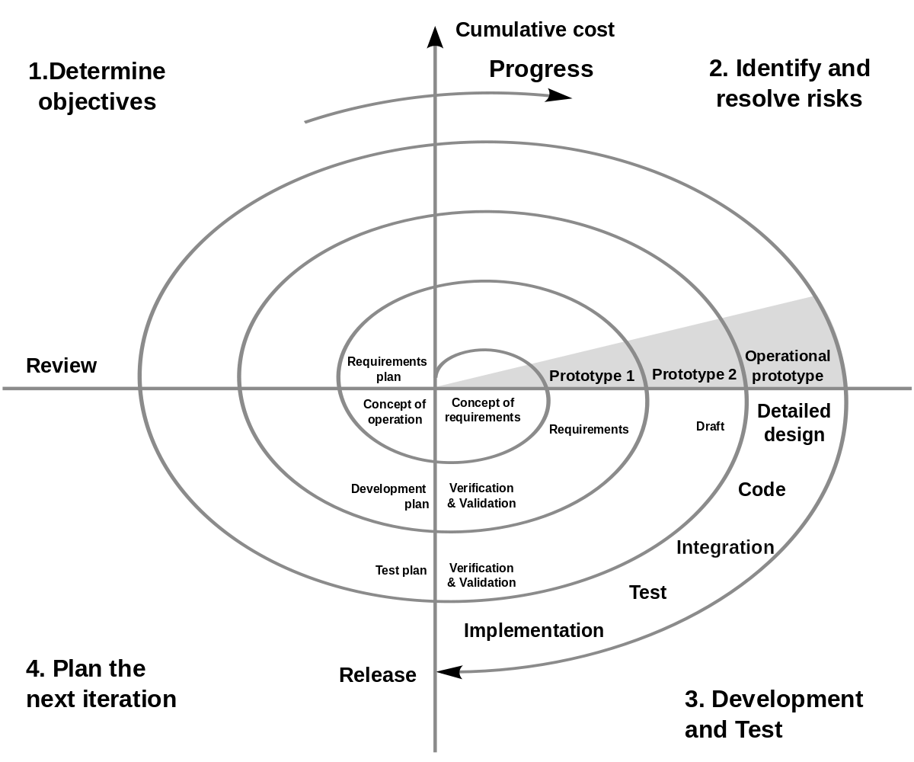
Diagram of Process Model

Slide 7
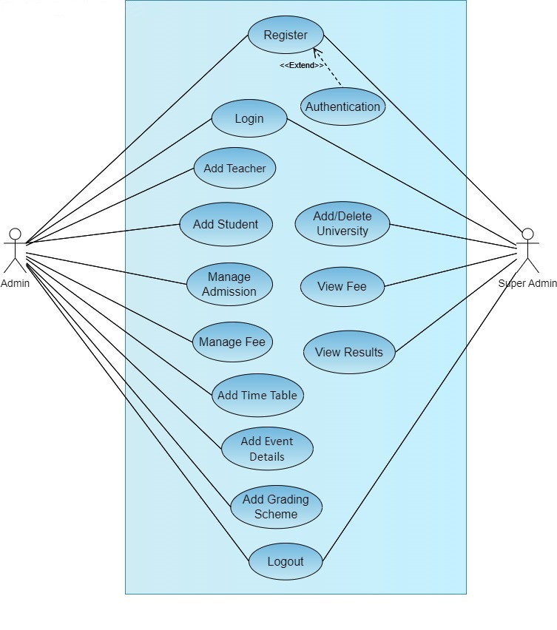
Use Case Diagram

Slide 8
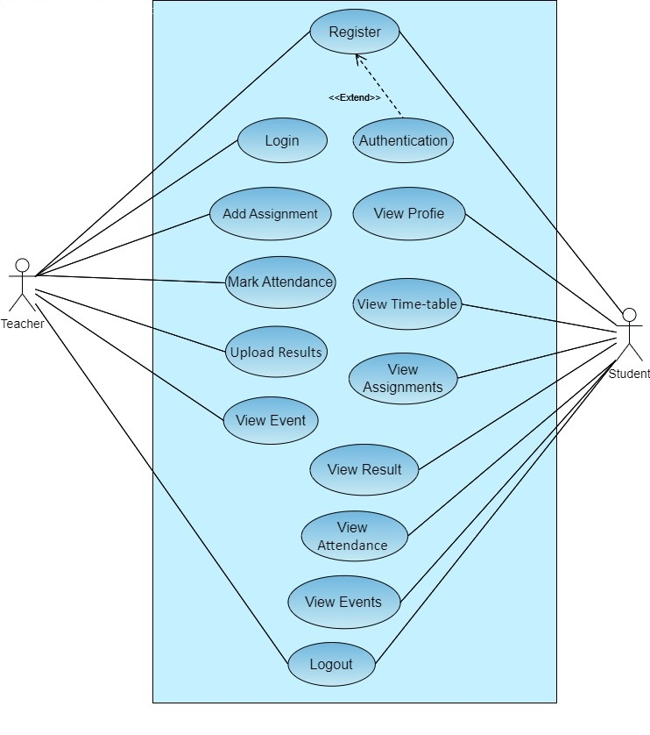
Use Case Diagram

Slide 9
Business Rules Catalog
Admin
Admin can login using valid credentials and perform various task such as Adding a Teacher, Student and also can view them.
Admin will manage student’s admission and fee history.
Admin will also add Time Table and Event details.
Admin will add grading scheme about Assignments, Quizzes, midterm and final term.

Slide 10
Business Rules Catalog
Teacher
Teacher can login and perform various task such as add assignment, mark attendance, upload result and view event.
Student
Student can access the system by providing valid credentials access modules such as viewing their own profile, view time-table, assignments, result, attendance and event.

Slide 11
Business Rules Catalog
Super Admin
Super admin is the root node who adds the university campus into the system with their details.
Also, super admin can view/delete any university campus from the system.
Super admin can take information regarding fee detail and result.

Slide 12
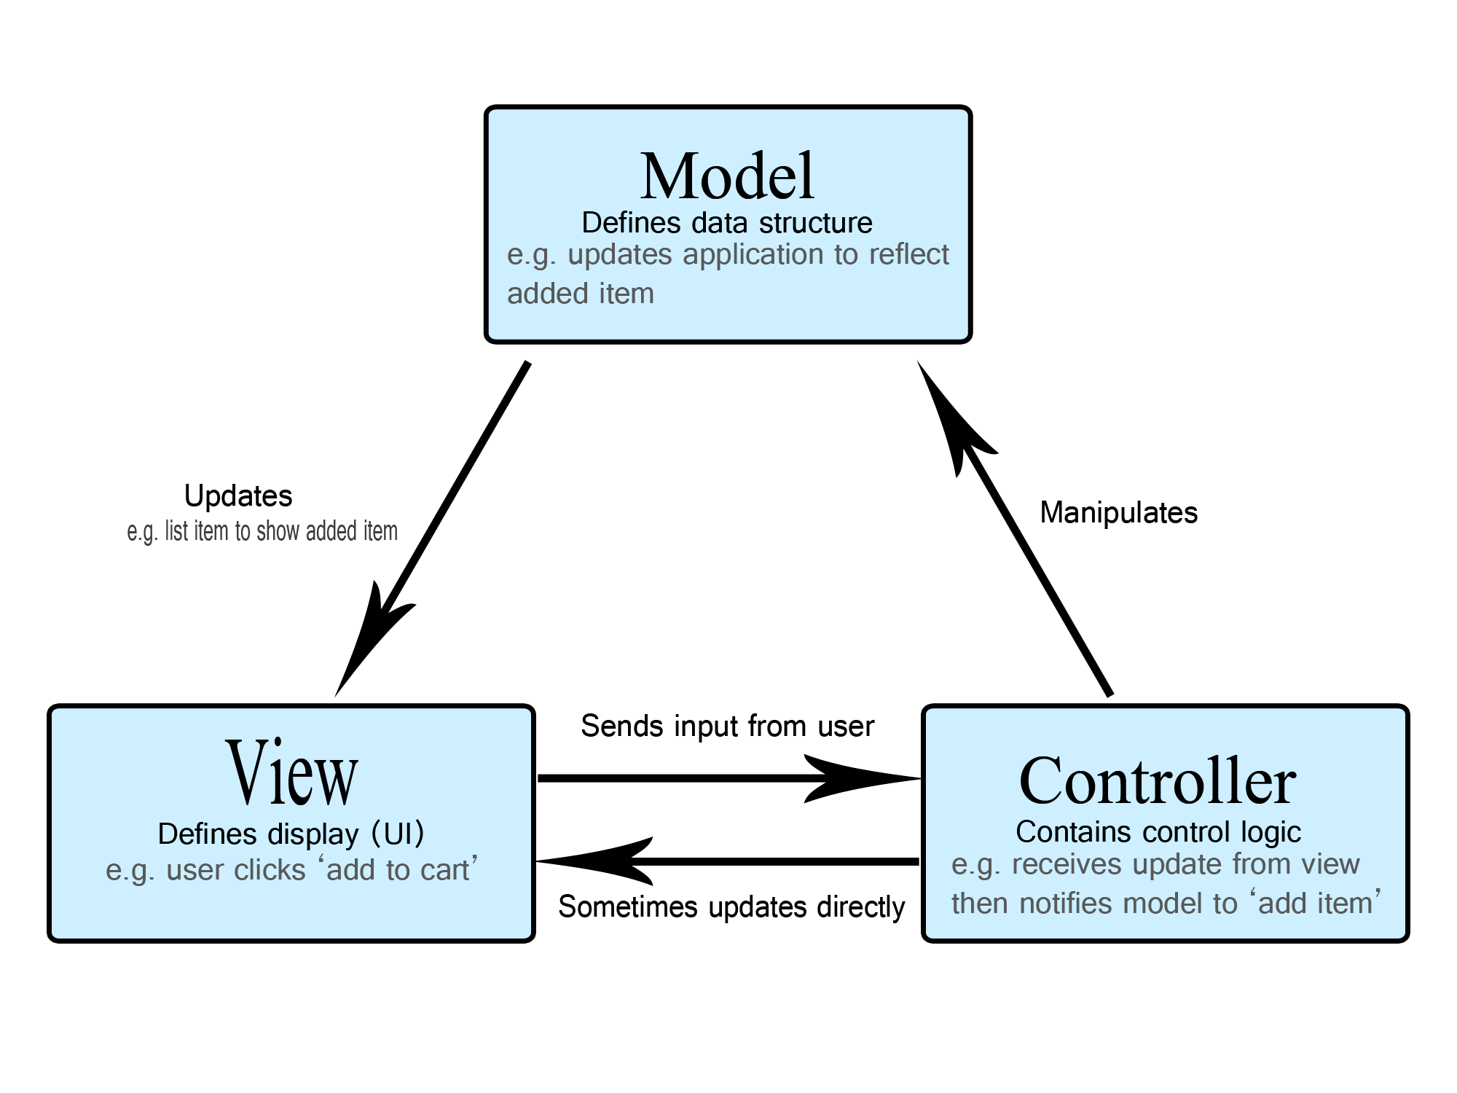
Architectural Design

Slide 13
Team Structure
F22021F975
Mubashra Munir BC180400924

Slide 14
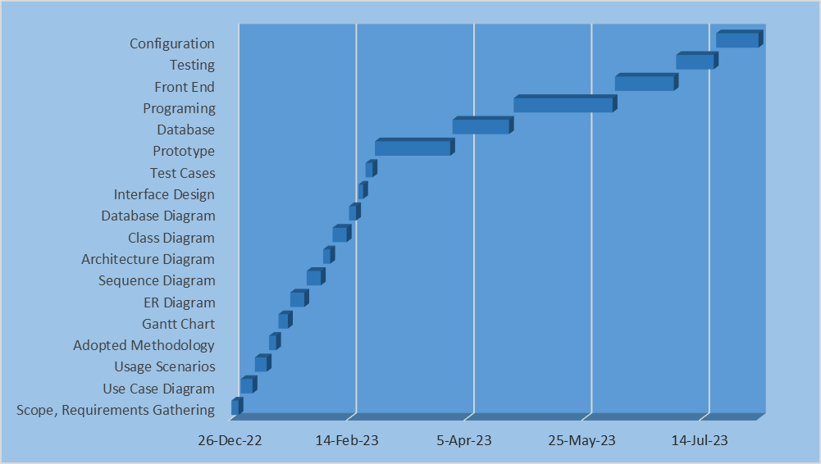
Project Schedule

Slide 15
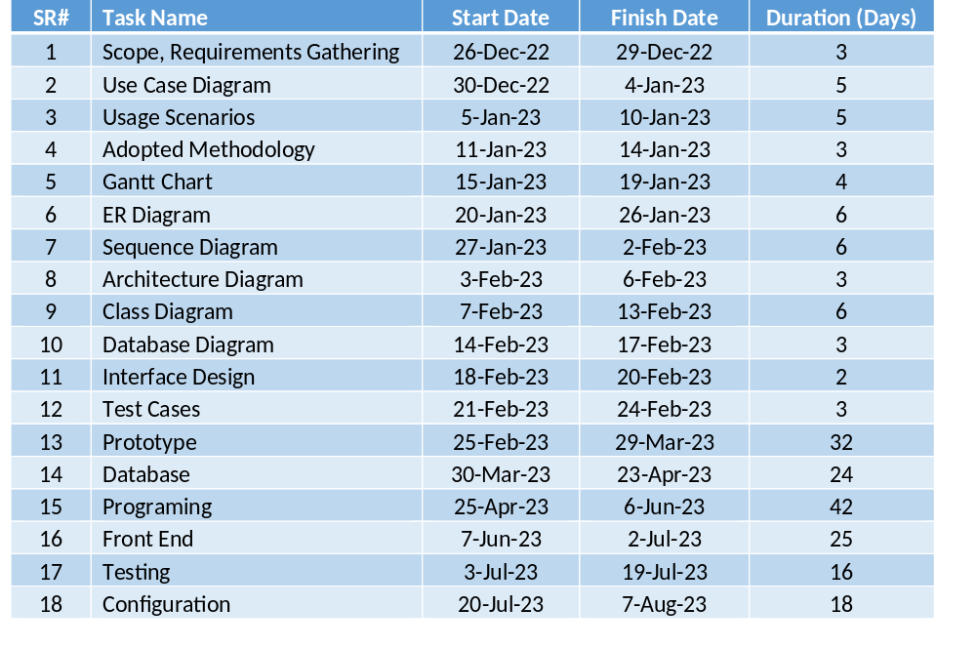
Project Schedule

Slide 16
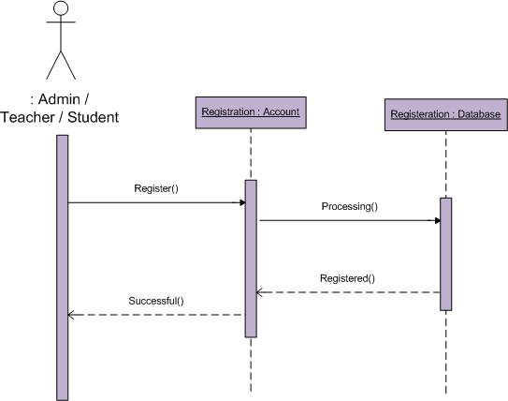
Sequence Diagrams
Registration:

Slide 17
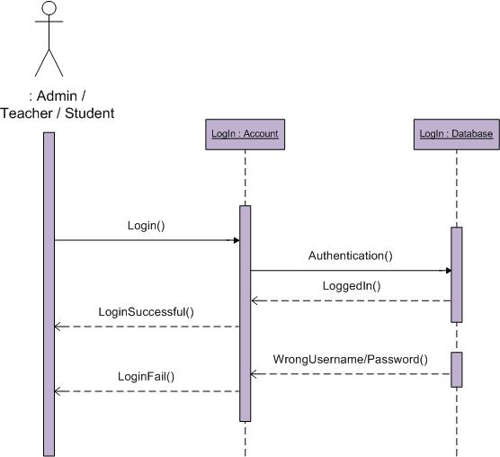
Sequence Diagrams
Login:

Slide 18
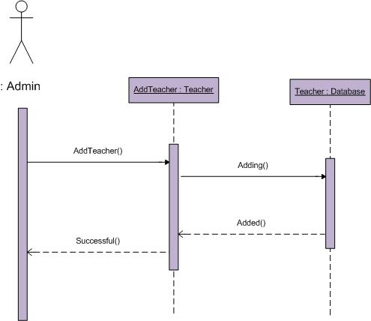
Sequence Diagrams
Add Teacher:

Slide 19

Sequence Diagrams
Add Student:

Slide 20
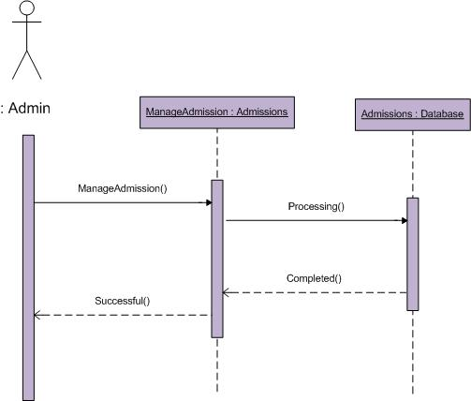
Sequence Diagrams
Manage Admission:

Slide 21
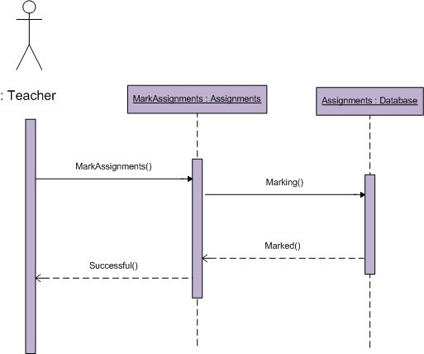
Sequence Diagrams
Mark/Evaluate Assignments:

Slide 22
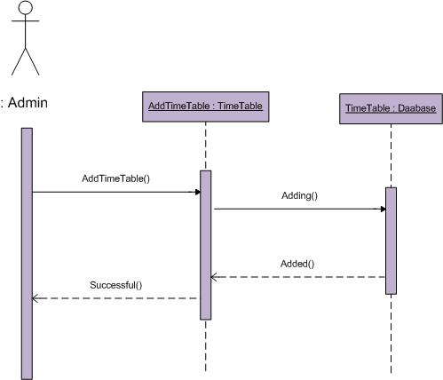
Sequence Diagrams
Add Timetable:

Slide 23
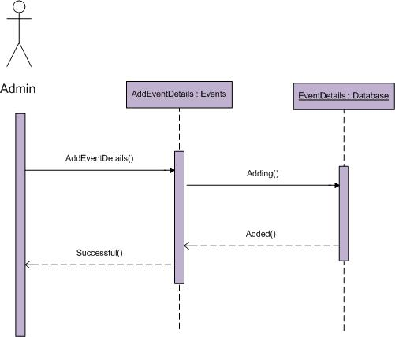
Sequence Diagrams
Add Event Details:

Slide 24
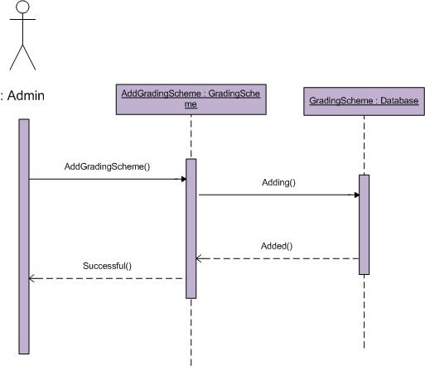
Sequence Diagrams
Add Grading Schemes:

Slide 25
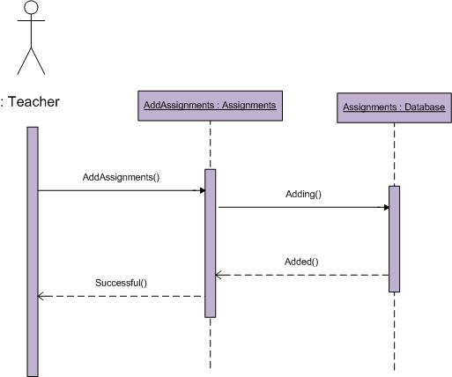
Sequence Diagrams
Add Assignments:

Slide 26

Sequence Diagrams
Mark Attendance:

Slide 27
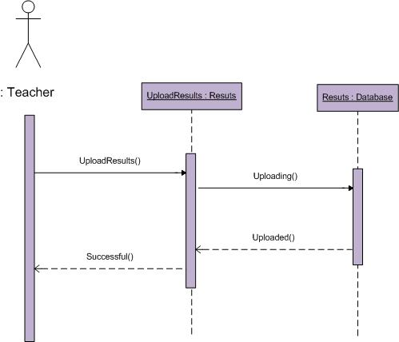
Sequence Diagrams
Upload Results:

Slide 28
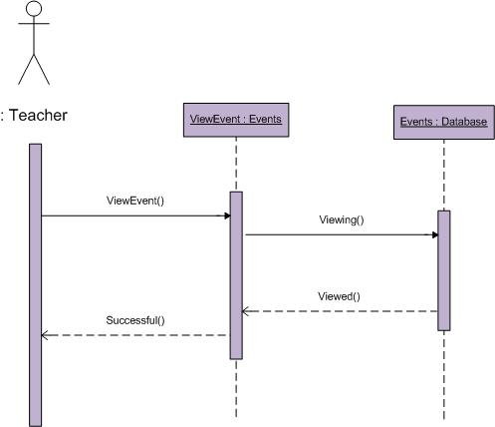
Sequence Diagrams
View Event:

Slide 29
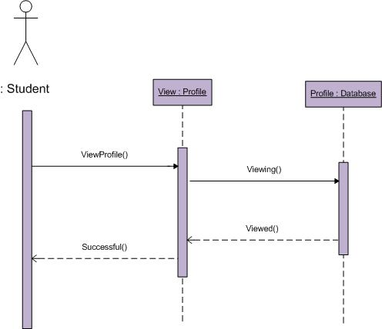
Sequence Diagrams
View Profile:

Slide 30
Sequence Diagrams
View Time Table:

Slide 31
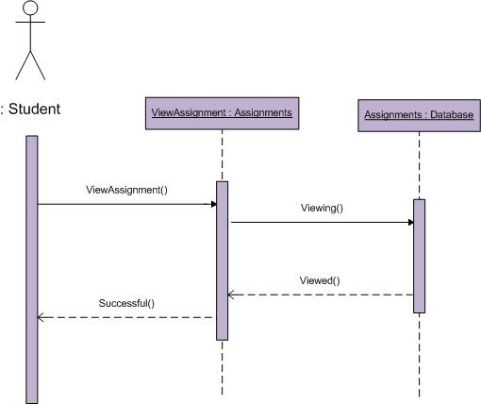
Sequence Diagrams
View Assignments:

Slide 32

Sequence Diagrams
View Result:

Slide 33

Sequence Diagrams
View Attendance:

Slide 34
Sequence Diagrams
View Events:

Slide 35
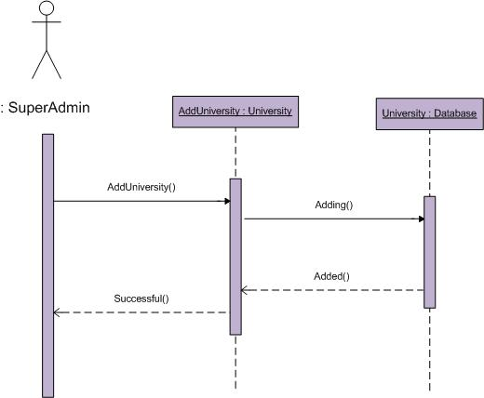
Sequence Diagrams
Add University Campus:

Slide 36
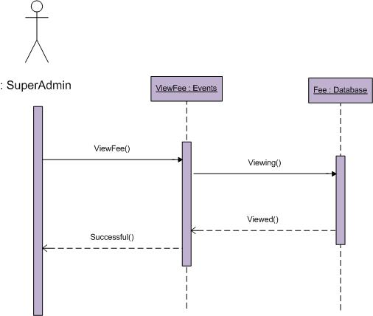
Sequence Diagrams
View Fee Details:

Slide 37
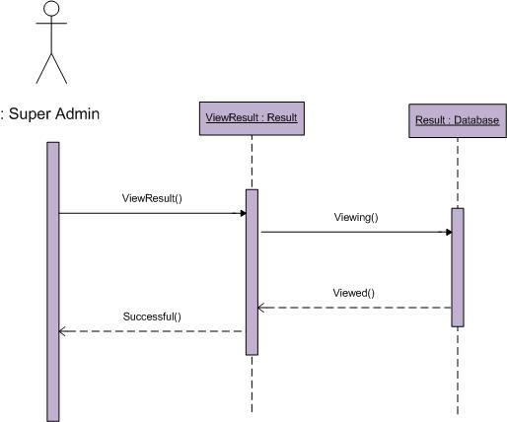
Sequence Diagrams
View Results:

Slide 38
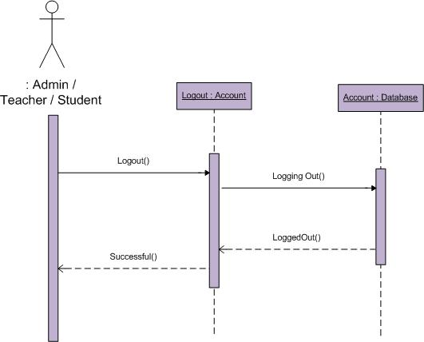
Sequence Diagrams
Logout:

Slide 39
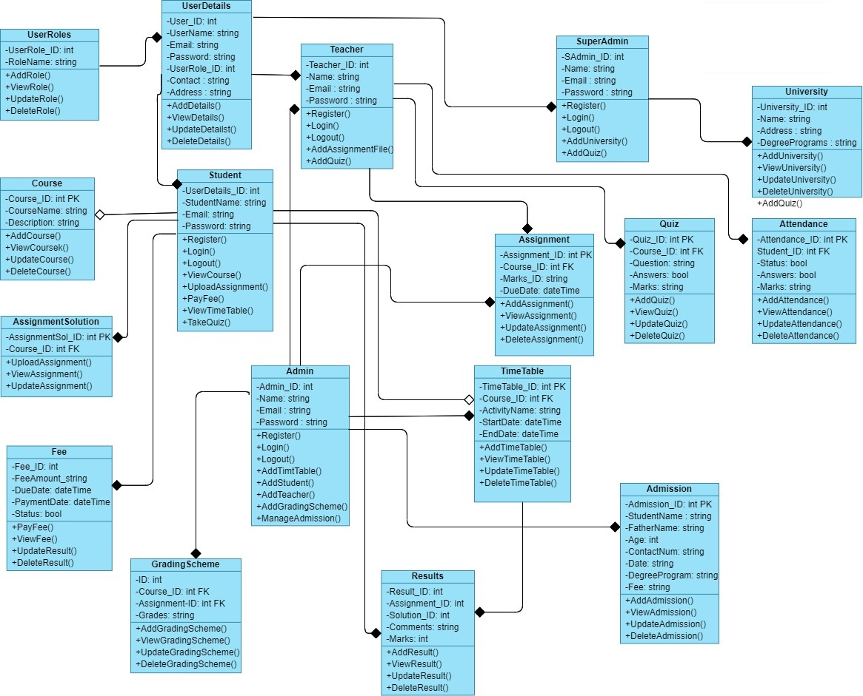
Logical Model/Class Diagram

Slide 40
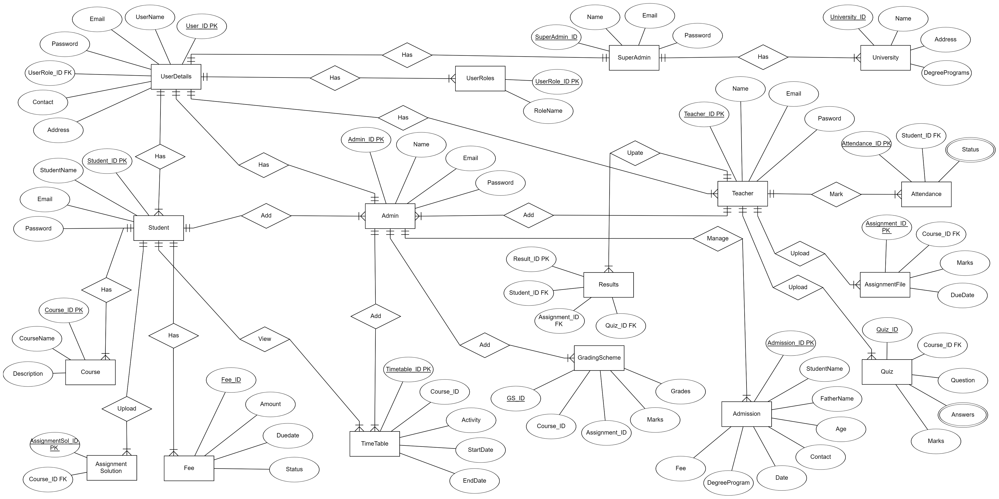
Entity-Relationship Diagram

Slide 41
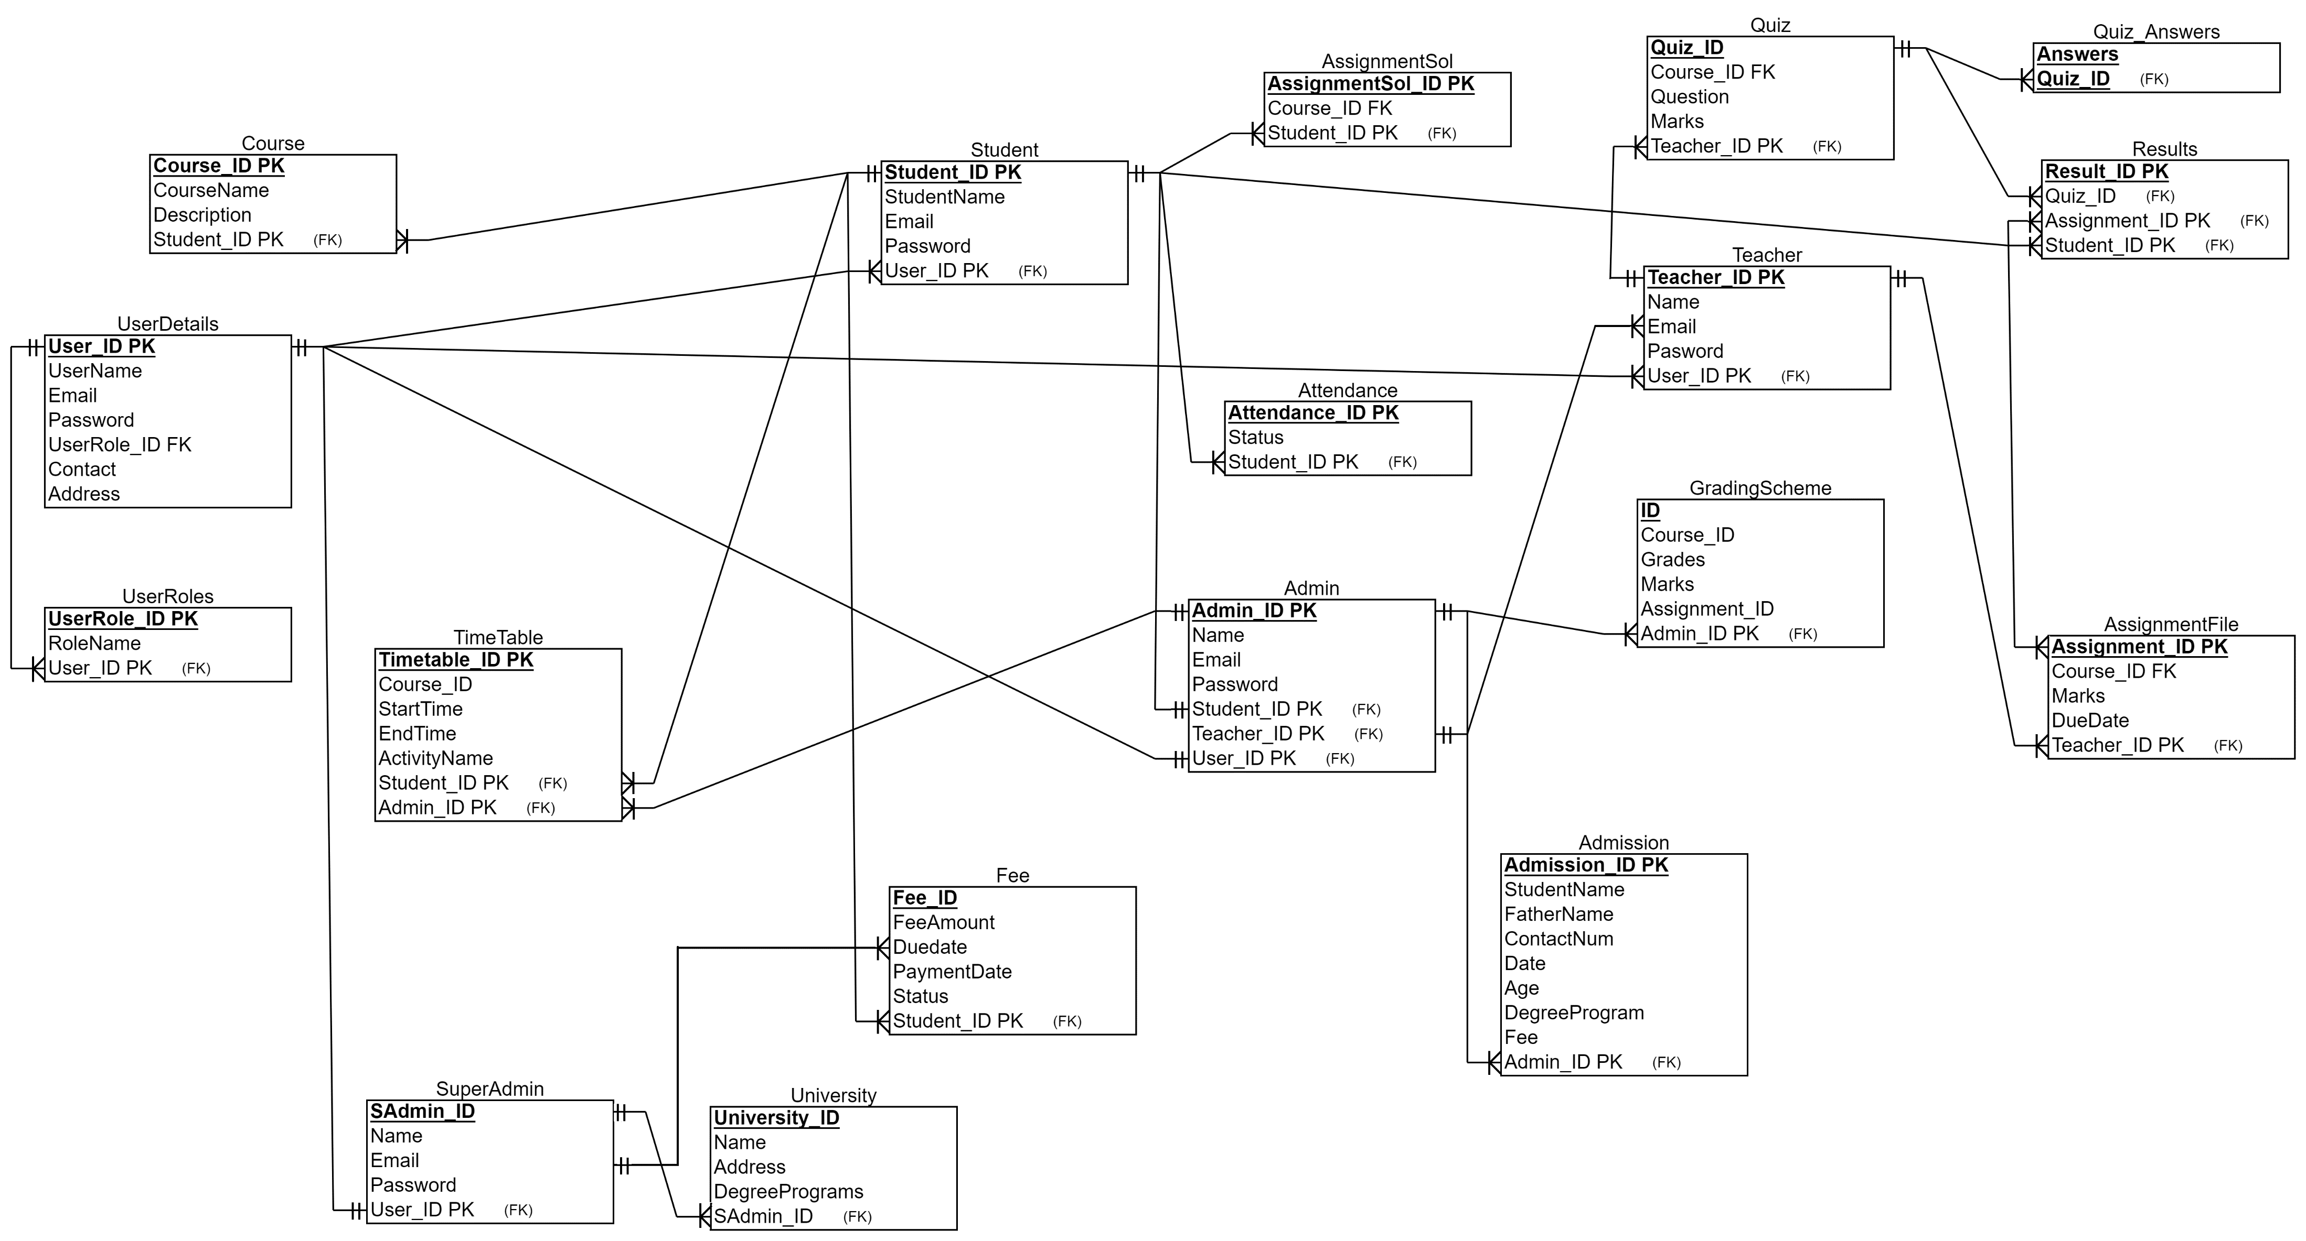
Database Diagram

Slide 42
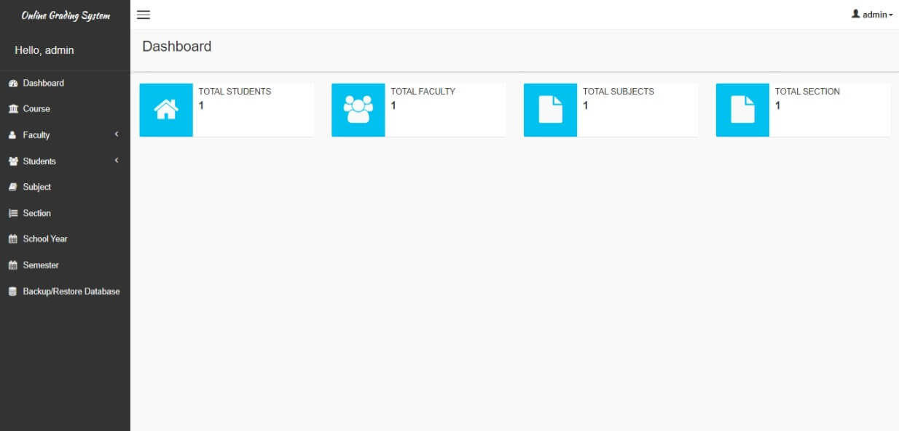
User Interfaces
Admin Dashboard:

Slide 43
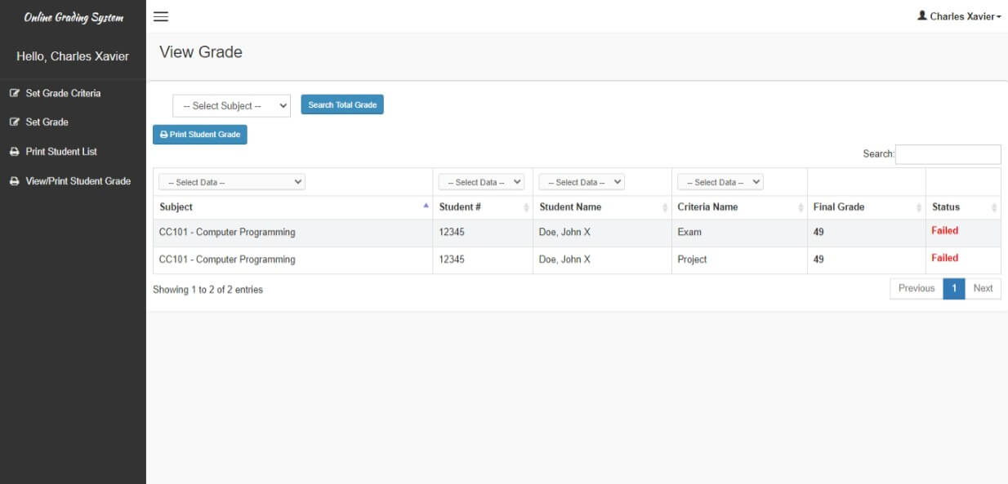
User Interfaces
Student’s Result:

Slide 44
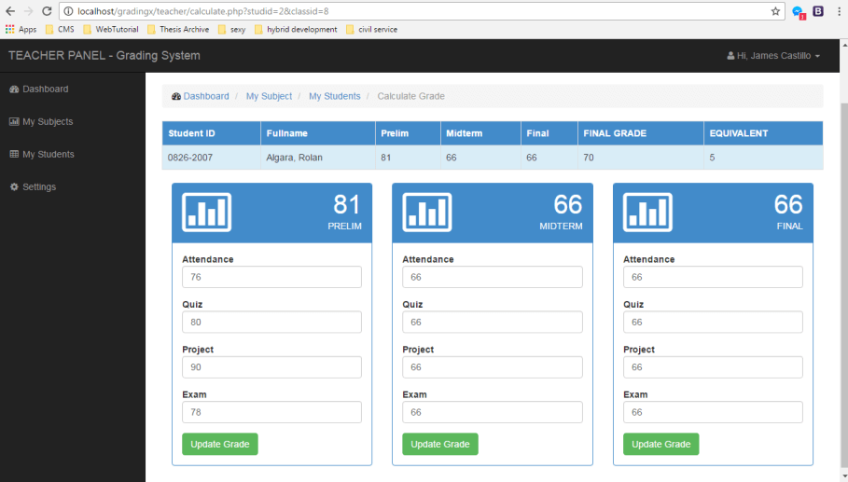
User Interfaces
View Grades:

Slide 45
User Interfaces
Admin Dashboard:

Slide 46
Tools
HTML
CSS
Visual Studio
C#
SQL Server

